Slide 1
Scene Management
Video Game Programming
Lecture 2: Scene Management

Slide 2
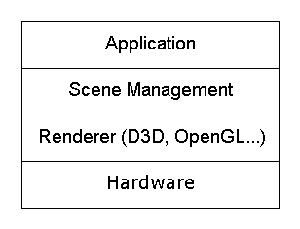
Scene Management
The scene management system maintains a world full of objects and determines what gets drawn and in what order
The scene management layer deals primarily with objects. The rendering layer deals primarily with triangles and graphics state.
Major components
  Culling (Toplamak, seçmek)
  Level of detail
  Draw order
  Off-screen rendering
  Paging

Slide 3
Culling

Slide 4
Culling Definition
The term ‘cull’ means to remove from a group. A common example is to cull from a herd (sürü) or flock.
In graphics, it means to determine which objects in the scene are not visible
Its usually more productive to think about it as determining which objects are visible

Slide 5
Culling Algorithms
Backface culling
View volume
  Bounding volume hierarchies (BV / BVH)
  Grid
Occlusion
  Portals
  Potentially visible sets (PVS)
  Hierarchical occlusion masks (HOM)
  Hierarchical Z-buffer
  Occlusion planes

Slide 6
Backface Culling
Backface culling is not really part of scene management- it is a lower level feature usually built into the rendering layer
Backface culling can actually slow down rendering sometimes!

Slide 7
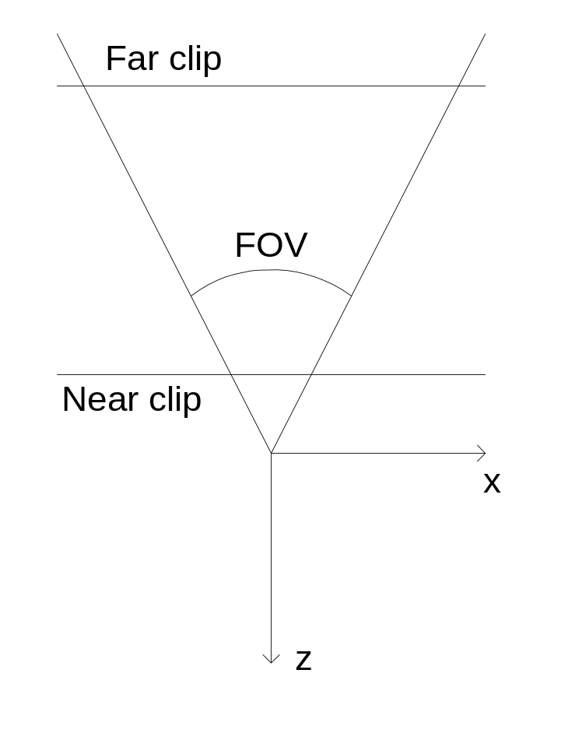
Cameras & View Volumes
Camera matrix
Field of view
Aspect ratio
Clipping planes

Slide 8
Bounding Volume Culling

Slide 9
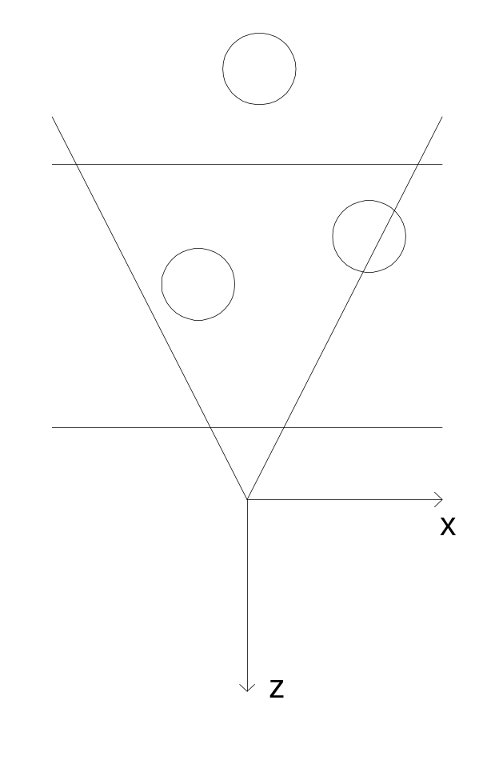
Bounding Volumes
Objects are contained within simple bounding volumes (sphere, cylinder, box…)
Before drawing an object, its bounding volume is tested against the camera’s viewing volume. There are 3 possible outcomes:
  Totally visible
  Totally invisible
  Partially visible (may require clipping)
Volumes can be hierarchical

Slide 10
Bounding Volume Types
Sphere
Cylinder
Hot dog / capsule / lozenge
AABB: axis-aligned bounding box
OBB: oriented bounding box
Convex polyhedron

Slide 11
Generating Bounding Spheres
Method 1: Average vertex positions
  Step 1: Compute average of all vertex positions and place the center of the bounding sphere there.
  Step 2: Find the vertex farthest from the center and set the radius to that distance
Will rarely, if ever, generate optimal results

Slide 12
Optimal Enclosing Sphere
Sphere ComputeSphere(int N,Point P[]) {
randomly mix up points P[0]…P[N-1];
Sphere sphere(P[0],0);
i=1;
while (i<N) {
if(P[i] not in support) {
if(P[i] not in sphere) {
add P[i] to support and remove any unnecessary points;
compute sphere from current support;
i=0; // start over when support changes
continue;
}
}
i++;
}
return sphere;
}

Slide 13
Testing Bounding Spheres
Transform bounding sphere to view space
Compare against all 6 view volume faces
Object is totally invisible if it is completely outside any one plane
Object is totally visible if it is completely inside all planes
Otherwise, the object may intersect the view volume and may require clipping

Slide 14
Transforming to View Space
Object’s world matrix: W
Camera’s world matrix: C
View matrix: V=C⁻¹
Projection matrix (not used): P
Sphere position in object space: s
Sphere position in view space: s´=s•W•V

Slide 15
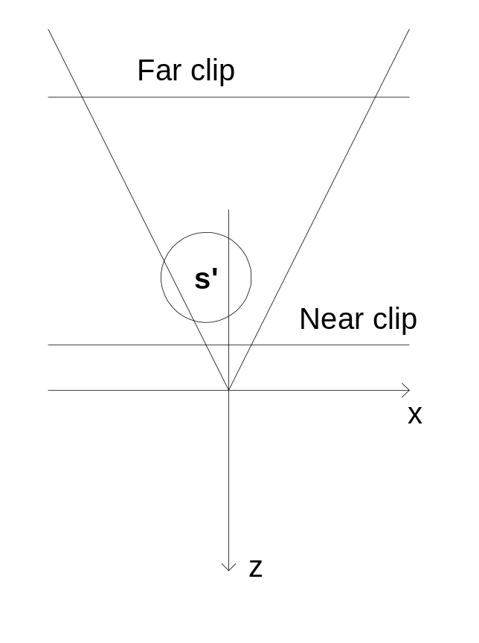
Testing Near & Far Planes
if(s.z-radius > -NearClip) then outside
else if(s.z+radius<-FarClip) then outside
else if(s.z+radius>-NearClip) then intersect
else if(s.z-radius<-FarClip) then intersect
else inside

Slide 16
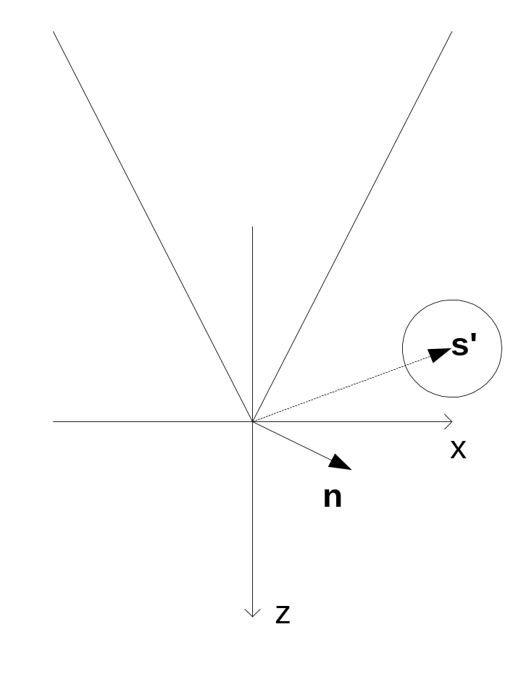
Testing Right, Left, Top, & Bottom
dist = n ^ s'
if(dist>radius) then outside
if(dist<-radius) then inside
else intersect
Right plane:
n=[cos(FOV/2), 0, sin(FOV/2)]
Top plane:
n=~[0, cos(FOV/2)/Aspect, sin(FOV/2)]

Slide 17
Performance
Transform sphere center to view space: 9*, 9+
Compare to near & far plane: 6+
Compare to left & right: 2*, 6+
Compare to top & bottom: 2*, 6+
Total: 13*, 27+

Slide 18
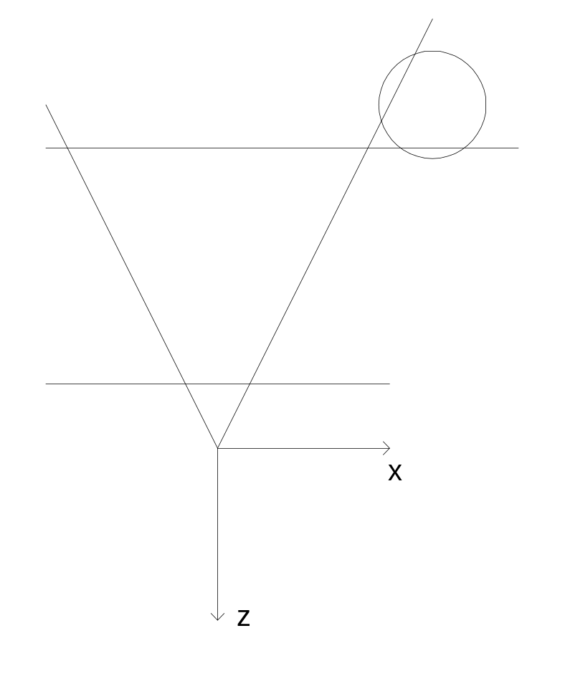
Special Case for Corners

Slide 19
Bounding Volume Hierarchies
Easy to extend bounding volume concept to hierarchies
Bounding hierarchies for static objects can be precomputed
Hierarchies for moving objects can be computed dynamically

Slide 20
Clipping Issues
Ideally, clipping and even clip testing of individual triangles should be avoided, especially on the PS2
If an object is totally visible, it should not be clip tested
If an object intersects the far clipping plane, we might just want to reject it entirely
If an object intersects the top, bottom, or side clipping planes, we might be OK using hardware scissoring
If an object intersects the front clipping plane, it probably needs to be clipped (or maybe we can reject individual triangles)
Consider differences in requirements between large objects (terrain) and small objects (characters, props)

Slide 21
Portal Culling

Slide 22
Portals
Culling algorithm designed specifically to handle interior environments (buildings, dungeons, mazes…)
Can work in conjunction with bounding volume hierarchies and other culling algorithms
World is made up of rooms connected by rectangular portals

Slide 23
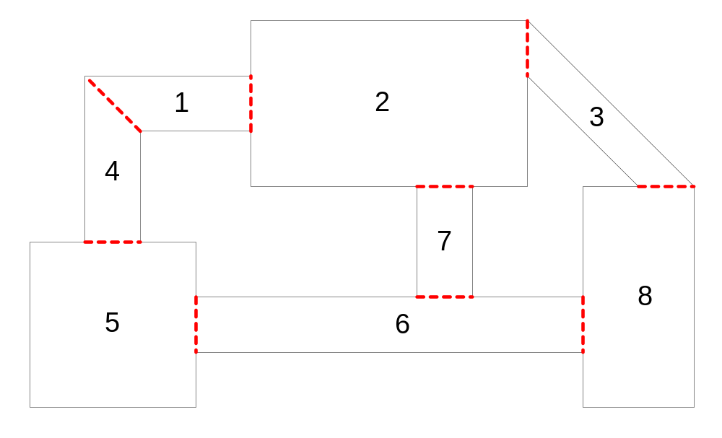
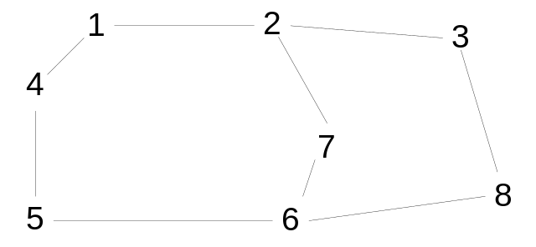
Portals

Slide 24
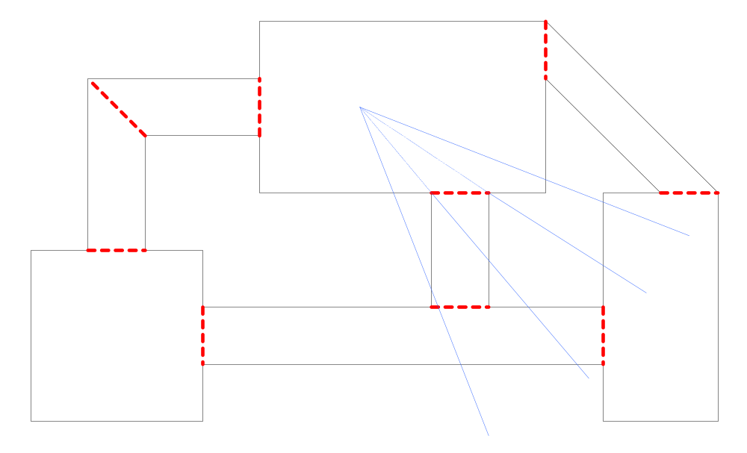
Portals

Slide 25
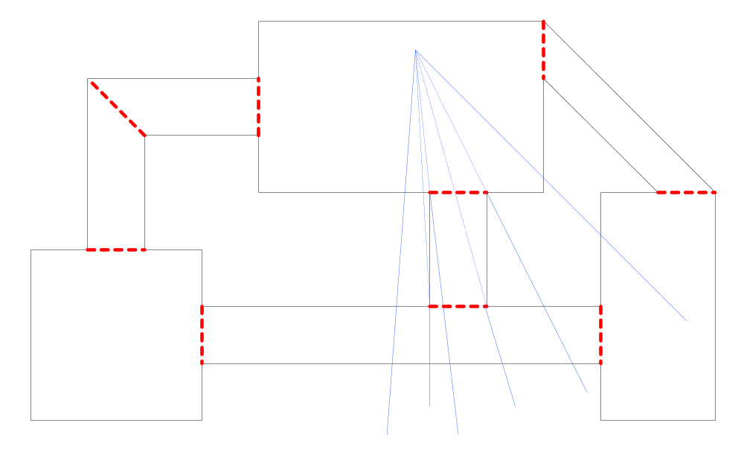
Portals

Slide 26
Portal Issues
Imposters
Portal clipping
Camera location
Combining with bounding volume culling
Moving objects
Dynamic portals (opening & closing doors)
Procedurally generating portals

Slide 27
PVS: Potentially Visible Sets

Slide 28
PVS Algorithm
Static world is broken up into individual renderable objects
The space of all legal camera positions is broken up into zones
A precomputed table is generated that lists for each zone, all objects that might be visible
Potentially visible objects are then further tested with bounding volume culling

Slide 29
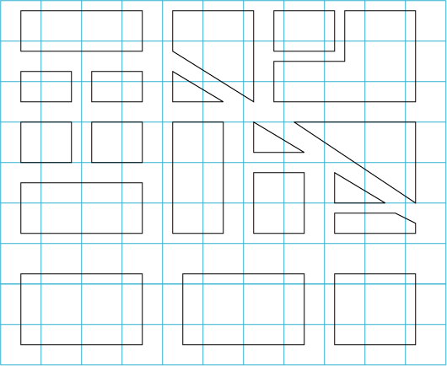
PVS

Slide 30
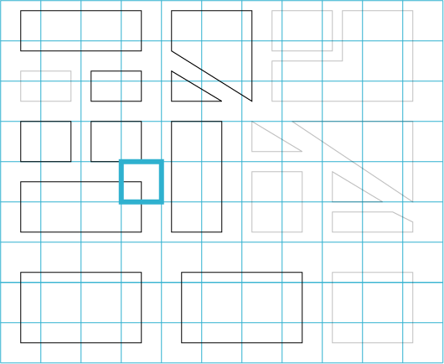
PVS

Slide 31
PVS Table Generation
for (zone=1 to num camera zone) {
for(i=1 to NUM_SAMPLES) {
Vector3 eye=GenerateLegalEyePosition();
for(j=1 to 6) {
image img=RenderBoxView(eye,j);
for (k=1 to num pixels in img) {
AddToPVS(zone, img.pixel[k]);
}
}
}
}

Slide 32
PVS Issues
Overall, the algorithm can work quite well and handle very complex culling situations efficiently
However, the PVS table can get quite large and require a lot of memory
Also, defining viewing zones can be tricky

Slide 33
Level of Detail

Slide 34
Discrete LODs
Several discrete LODs are prepared off line and dynamically switched based on simple distance comparisons (ideally it should take the camera FOV and resolution into account too)
Tried and true method used for many years in flight simulation
Basically no CPU overhead for algorithm itself
Hardware is well adapted to rendering static display lists
Additional memory required for storing LODs, but all low LODs together are usually smaller than the high LOD
Can use sophisticated mesh decimation tools off line for preparing models
If desired, techniques exist for cross dissolving (fading) between LODs
Bottom line: very fast and very simple (quick & dirty)

Slide 35
Progressive Meshes
Automated mesh decimation and dynamic reconstruction technique
Can take any model and then render it dynamically with any number of polygons (less than or equal to the original number)
Requires about 1/3 extra memory (or more, depending on details of the implementation)

Slide 36
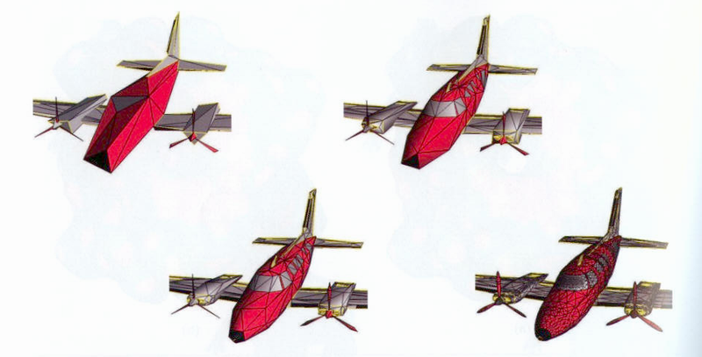
Progressive Meshes

Slide 37
Progressive Mesh Performance
Rendering requires custom processing at the per-vertex and per-triangle level, and so the algorithm, while pretty efficient, has trouble competing with the simpler discrete LOD technique. In other words, even though it may be able to render fewer triangles, the per-triangle cost is higher, usually making the overall approach slower.
Neat technology and useful research, but hasn’t been too successful in video games just yet. Future graphics hardware may have better support for progressive meshes, and so they may be more important later. Also, mesh decimation technology is still very useful in off line modeling.

Slide 38
Patches & Subdivision Surfaces
Geometry is defined by a control mesh that explicitly describes a high order surface
Surface is dynamically tessellated into polygons, based on camera distance and other visual quality controls
Patches & subdivision surfaces allow for smooth, rounded surfaces to be described without using tons of memory
Overall approach suffers from similar drawbacks to progressive meshes as far as its usefulness to games

Slide 39
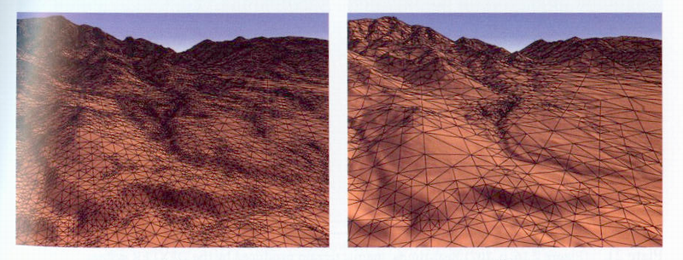
Terrain Rendering

Slide 40
LOD Issues
Color & lighting (normals) pops are more visible than geometry or silhouette pops
Camera is often moving and there are often many dynamic objects in the scene. This can help mask LOD transitions
Ideally, LOD should be pixel error based

Slide 41
More Scene Management

Slide 42
Load Balancing
LOD tolerances can be dynamically adjusted to provide a stable framerate
Uses timers to analyze how long the last frame took to render, then adjusts LODs so that current frame makes the most of available CPU time

Slide 43
Off-Screen Rendering
Imposters
Shadows
Environment maps
Full-screen effects (image distortion, blurs, color processing…)
Other visual effects…

Slide 44
Draw Order
Transparency
Alpha effects
Z-Buffer effects
Off-screen rendering
Caching performance
Buckets
Depth sorting
Multiple cameras

Slide 45
Scene Draw Order Example
Render any off-screen textures
Draw sky (clears framebuffer and z-buffer)
Draw all opaque objects
Draw all transparent objects and localized effects, sorted back to front at the object level. Individual objects and effects could sort at the polygon level if necessary
Full-screen image processing effects (color processing, image warping, camera fade…)
Heads-up display (HUD)

Slide 46
Paging
Modern 3D worlds are too big to fit in game machine memory (32 megs on PS2, 64 on XBox, 24+8 on GameCube)
Data can be dynamically paged off of the DVD ROM drive
Must compete with audio & other streaming data

Slide 47
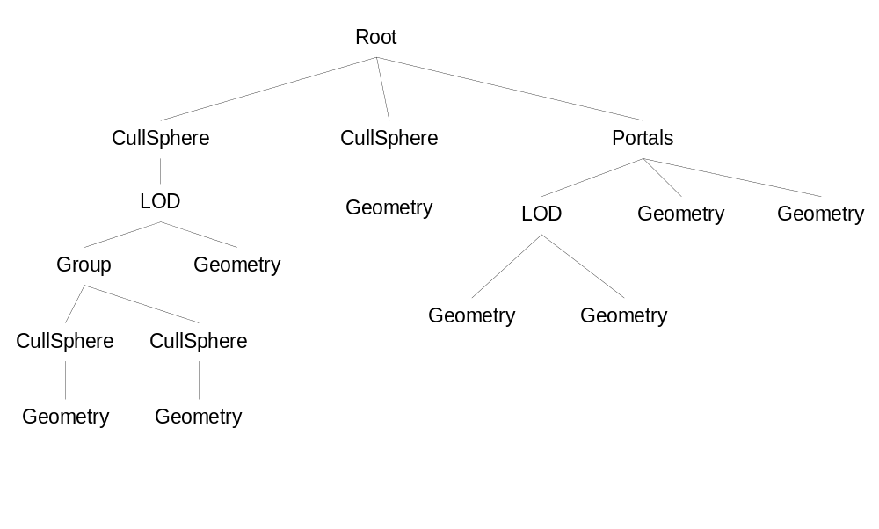
Scene Hierarchy

Slide 48
Case Study: Smuggler’s Run

Slide 49
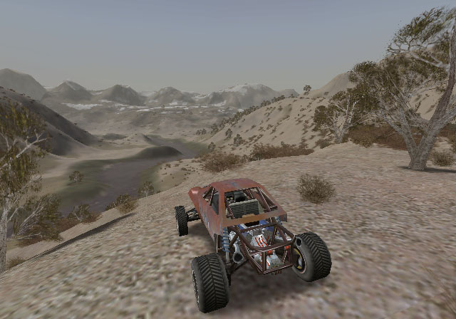
Smuggler’s Run

Slide 50
SR Terrain
Uniform grid, up to 1024x1024 cells
5 meter spacing for data points
32 bits per cell (height, texture ID, other misc. data)
Custom tool (Traxx) used to build terrains & set up gameplay

Slide 51
SR Terrain Rendering
Terrain units are culled by projecting the camera view volume onto the XZ plane and using a triangle filling algorithm to find visible cells
In addition to culling, this provides full control over draw order
Terrain is rendered in two groups: distant terrain and close terrain
Distant terrain starts at 1x1 and goes down to 1/8x1/8. Distant terrain is rendered as 1 pass using a pre-made ‘satellite’ photo texture
Close terrain starts at 1x1 and goes up to 8x8 using monotonic cubic interpolation. Close terrain renders with up to 3 passes (base, roads, & shadow)
Custom PS2 microcode used to render actual 8x8 tiles

Slide 52
SR Level of Detail
Terrain can res up to as much as 8x8 or down to as little as 1/8x1/8
Individual objects (cars, buildings, props) can have up to 3 LODs
LOD compensates for split-screen multiplayer modes
Some dynamic load balancing is also used

Slide 53
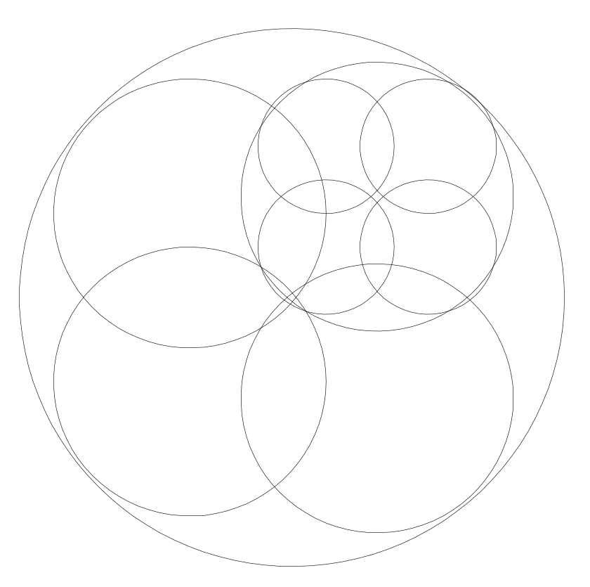
SR Trees
Quad/sphere-tree stored for each type of plant
Imposter objects used for distant trees
Close trees drawn as geometry using custom instancing microcode
Alpha & z-buffer tricks used to minimize need for sorting

Slide 54
SR Draw Order
1. Sky
2. Render distant terrain
3. Render shadow off-screen
4. Render close terrain
4a. Base
4b. Roads
4c. Shadow
5. Cars
6. Props
7. Trees
8. Particles, effects
9. Copy to front

Slide 55
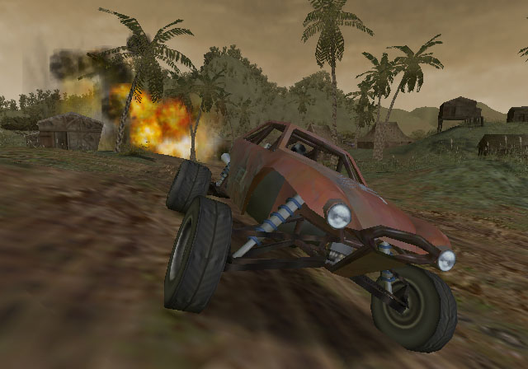
SR

Slide 56
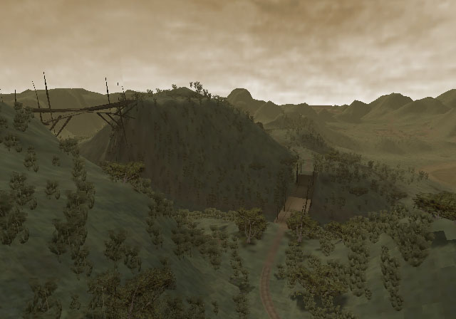
SR

Slide 57
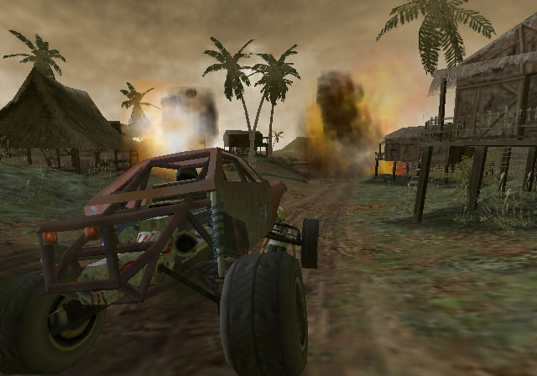
SR

Slide 58
Conclusion

Slide 59
Reference
“3D Game Engine Design” by Eberly has lot of info and algorithms for various bounding volume types
“Real Time Rendering” by Moller & Haines has a lot of info on various culling schemes
“Level of Detail for 3D Graphics” by Luebke, et al., has tons of info on various LOD schemes

